Slide 1
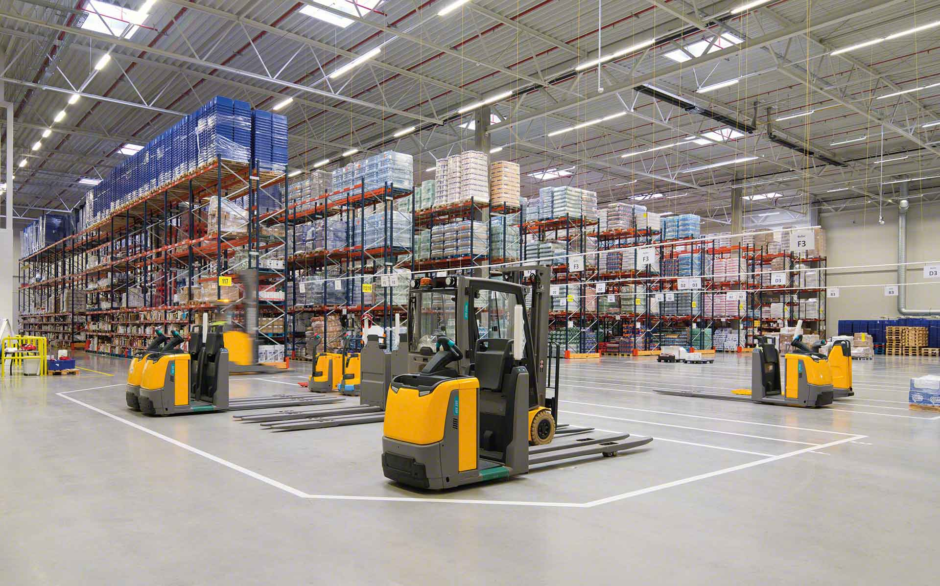

Material Handling KPI
Semana 1 octubre 2022

Slide 2
Movements November
October week one movements
1204
November weekly movements
687
Row Labels | Sum of MAT HANDLE | Sum of TOTAL
amiranda | 336 | 336
erojas | 352 | 353
jodelacr | 140 | 155
jtobias | 214 | 216
judelato | 143 | 144
Grand Total | 1185 | 1204
User | Sum of CYCLE COUNTS | Sum of MAT HANDLE | Sum of cc MH
judelato | 0 | 242 | 242
erojas | 0 | 242 | 242
amiranda | 0 | 184 | 184
jodelacr | 0 | 19 | 19
Grand Total | 0 | 687 | 687

Slide 3
Adjustments
Adjustments difference
-$584.51
Adjustments difference
-$616.42
Row Labels | Sum of COST | Count of PART
erojas | -14.86 | 1
jodelacr | -917.38 | 15
jtobias | 159.93 | 2
judelato | 187.8 | 1
Grand Total | -584.51 | 19
Row Labels | Sum of COST | Count of PART
judelato | $187.80 | 1
jtobias | $61.10 | 1
jodelacr | -$865.32 | 12
Grand Total | -$616.42 | 14

Slide 4
Labor intensive
Class not slotted count
18
Labor Intensive
34

Slide 5
rESTOCK
Part Numbers stocked
277
Part Numbers stocked
240

Slide 6
Empty locations
Week empty locations
317

Slide 7
Discrepancies
Date | Sum of Locaciones
29 Agosto- 2 Septiembre | 25
5 - 9 Septiembre | 15
12- 16 Septiembre | 15
26-30 Septiembre | 13
19-23 Septiembre | 10
3-7 Octubre | 5
Grand Total | 83
Total week discrepancies
5

Slide 8
Consolidation
Row Labels | 29 DE SEPTIEMBRE | 6 DE OCTUBRE
12313 | 9 | 9
38405 | 9 | 7
11103391 | 9 | 7
13213 | 8 | 7
1054267V01 | 8 | 7
37021 | 8 | 6
1054268V01 | 8 | 7
0185918 | 8 | 7
1088069V01 | 8 | 7
33082 | 8 | 8
70714 | 8 | 7
1024818 | 8 | 5
12211 | 8 | 7
0530096 | 8 | 5
13114 | 8 | 6
71067 | 7 | 4
39116 | 7 | 5
95305 | 7 | 4
36314 | 7 | 6
70716 | 7 | 2
Grand Total | 158 | 123
Total week consolidations
35

Slide 9
Distribution warehouse
Row Labels | Count of Item
01 - FASTENERS | 1388
10 - SAFETY SUPPLIES | 507
02 - TOOLS AND ACCESSORIES | 134
04 - HYDRAULICS AND PNEUMATICS | 108
06 - JANITORIAL SUPPLIES | 90
03 - CUTTING TOOLS | 80
15 - MFG Standards | 77
07 - ELECTRICAL SUPPLIES | 60
50 - CLEARANCE | 58
08 - Welding & Abrasives | 42
05 - MATERIAL HANDLING | 41
16 - Office Products | 34
95 - FASTENAL WORK WEAR | 23
97 - GENERAL SUPPLIES | 20
90 - PACKAGING MATERIAL | 12
99 - FASTENERS - SEMI-STANDARDS | 7
30 - SERVICE BANDSAW WELDING | 3
09 - MFG SPECIALS DIVISION | 3
33 - SERVICE REGRIND SHARPCUT | 2
14 - METALS-ALLOYS AND MATERIALS | 1
Grand Total | 2690

